Slide 1


An Introduction to ASQ-3™
Ages & Stages Questionnaires®, Third Edition (ASQ-3™)
A Parent-Completed Child Monitoring System
Ms. Tortora
Prospect School
September 2, 2021

Slide 2
What are ASQ-3 and ASQ:SE?
Parent- or caregiver-completed screening tools that encourage parent/caregiver involvement
Series of questionnaires for children ages 1 month to 5 ½ years
Tools to accurately identify children at risk for developmental or social-emotional delay
Notes:
Parent/Caregiver completed. All of the research on the ASQ was conducted with a primary caregiver completing the form, so we know little about how accurate results are if, for example, a childcare provider completes the tool. (For the ASQ:SE, caregivers need to have at least 20 hours of contact with the child during the week).
Optional Activity: Ask Participants, "Why is it important to include parents in the screening process?”
Possible answers include:
Parents know children best, so they are good sources of information
Parents can learn about child development
Parents are seen as the expert, which can be empowering
Includes parents as part of the team
Facilitates communication between provider and parent regarding child’s development

Slide 3

ASQ-3 Domains
ASQ-3
Communication
Gross motor
Fine motor
Problem solving
Personal-social
Notes:
Review slide.
ASQ-3 covers 5 Domains of Development.
Explain that ASQ:SE was developed as a companion tool to ASQ in order to address the need for age-appropriate tools to monitor very young children’s behavior and address parental concerns.

Slide 4

Screening Assessment
A brief assessment procedure designed to identify children who should receive more intensive diagnosis or evaluation from local early intervention (EI),
early childhood special
education (ECSE),
health, mental health
agencies.
Answers the question:
"Does the child need further evaluation?"
Notes:
Exercise: Materials: Overhead projector w/transparency paper & marker or flipchart pad & markers
1) Ask participants to identify what types of screening tools they have used in their agencies.
2) Ask participants to identify 1 word that typifies screening. Write these words down and discuss screening using those words. (Examples: funnel, sand sifter, snapshot)
Also, remind participants (see slide "ASQ and ASQ:SE Development") that ASQ and ASQ:SE items are not to be used as targets for intervention or for goals/objectives. The results can let you know, however, what development domain or behavioral area to focus interventions efforts on.
Examples of Screening tools:
The Ages & Stages Questionnaires® (ASQ) , DIAL-3, Early Screening Inventory (ESI), Revised Developmental Screening Inventory (RDSI), Parent’s Evaluation of Developmental Status (PEDS).
Examples of SE Screening Tools: Temperament and Behavior Scales (TABS), BITSEA (Brief Infant/Toddler Social-Emotional Assessment), Devereux Early Childhood Assessment (DECA)
Developmental screening similar in theory to health screenings such as a quick hearing or vision screen.

Slide 5


WHY SCREEN?
Under Detected
Clearly
Typical
Clearly
Atypical
?
Adapted from Macias, M. (2006) D-PIP Training Workshop

Slide 6
WHY SCREEN?
Under Detected
Clearly
Typical
Clearly
Atypical
?
Adapted from Macias, M. (2006) D-PIP Training Workshop

Slide 7
Screening
Beyond cutoff
(high risk)
Near cutoff
(risk)
Not near cutoff
(no risk)
Professional
Assessment
Continue to Monitor (Re-Screen) & use Curriculum-Based Assessment to develop learning plans
Eligible
Not Eligible
Notes:
This is an example of how screening with ASQ and ASQ:SE fits into a system to help identify children at risk for developmental delays. The process starts at the top by screening all children, and then children fall into 3 categories:
Not Near Cutoff (Above ASQ-3 Monitoring Zone, Well Below ASQ:SE)
Near Cutoff (Monitoring Zone of ASQ-3)
Beyond Cutoff (Below ASQ-3, Above ASQ:SE)
Children who fall beyond the cutoff are sent to local Part C or Part B Early Intervention/Early Childhood Special Education, health or mental health agencies for further diagnostic evaluation.
NOTE: One of the dilemmas you will encounter when screening for social-emotional delays is the lack of appropriate referral agencies—especially for babies and toddlers. You can start with EI/ECSE agencies, but if no specific EI/ECSE mental health or behavioral programs exist consider referrals to parenting programs, home visiting health, or other mental health programs. We are pioneers in this field and need to use tools to justify our referrals, document the need for services, and advocate to our agencies/government for the need for more services.
Children who fall near the cutoff are either sent for diagnostic evaluation and/or provided access to community-based or prevention programs and monitored closely. Follow-up will depend on program resources and state eligibility criteria. Children who are not near the cutoff should also be monitored. In many programs (e.g., Early Head Start, state preschools), children should also be assessed with a curriculum-based assessment tool to determine learning goals or targets for intervention.
Important Point! Note that children who are eligible for services are no longer screened. These children may be assessed with a curriculum-based assessment to determine functional goals to work on but at this point the screening tool is not needed anymore (and in most cases would be inappropriate to continue using).

Slide 8
Detection Rates of
Children with Existing Delays
 | Without Screening Tools | With Screening Tools
Developmental Disabilities | 14-54% identified Sheldrick et al, 2011 | 70-80% identified Squires et al, 1996
Mental Health Problems | 20% identified Lavigne et al, 1993 | 80-90% identified Sturner, 1991
Courtesy of START
Notes:
Research mentioned in this slide emphasizes the importance of using screening measures - even the "experts" i.e., pediatricians, miss many children if they do not use a high-quality screening tool. The AAP recommends screening all young children at 9, 18, and 24 (or 30) months. (American Academy of Pediatrics: Developmental Surveillance and Screening of Infants and Young Children, Pediatrics, (2011), 108, 1, 192-196.)
Sheldrick, R.C., Merchant, S. & Perrin, E.C. (2011) Identification of developmental and behavioral problems in primary care: A systematic review. Pediatrics, July 4, 2011. downloaded 7/18/2011 from:
http://pediatrics.aappublications.org/content/early/2011/06/29/peds.2010-3261
Palfrey, J. S., Singer, J.D., Walker, D.K. & Butler, J.A. (1994). Early identification of
children’s special needs: A study in five metropolitan communities. Journal of Pediatrics, 111, 651-655
Squires, J., Nickel, R.E., & Eisert, D. (1996). Early detection of developmental problems: Strategies for monitoring young children in the practice setting. Journal of Developmental and Behavioral Pediatrics, 17(6), 410-427.
Lavigne, J., Binns, H., Christoffel, K., Rosenbaum, D., Arend, R., Smith, K., et al. (1993). Behavior and emotional problems among preschool children in pediatric primary care: Prevalence and pediatricians' recognition. Pediatrics, 91, 649-655.
Sturner, R.A. (1991). Parent questionnaires: Basic office equipment? Journal of Developmental and Behavioral Pediatrics, 12, 51-54.

Slide 9

Features of the
Notes:
Have participants take out their 16-month ASQ-3 while reviewing features of ASQ-3.

Slide 10
Features: ASQ-3 Intervals
21 Questionnaire intervals:
  2, 4, 6, 8, 9, 10, 12, 14, 16, 18, 20, 22, 24
  27, 30, 33, 36 (spaced 3 months apart)
  42, 48, 54, 60 (spaced 6 months apart)
Notes:
There are 21 ASQ-3 intervals. Note that intervals are spaced 2 months apart until 24 months, 3 months apart from 24-36 months, and 6 months apart from 36-60 months.
The 9 month interval was designed for health care providers who do 9 month well baby check-ups. It has the same items as the 10 month questionnaire (would recommend only using this interval in health settings to coordinate with well child check-ups).

Slide 11
Features: ASQ-3 Cover Page
  Administration window indicated on ASQ-3 cover page
  16-month "window" is for children ages 15 months 0 days through 16 months 30 days
  Programs can personalize questionnaires by replacing the logo of the mother and child (on the top right)
Notes:
ASQ-3 administration windows have been "stretched" so that there is always an appropriate ASQ-3 interval to administer.
Note: If a child’s score is questionable and his/her age is on the younger or older end of these stretched windows, this should to be taken into consideration when interpreting results and making referral decisions.
Handout: "ASQ-3 and ASQ:SE Age Administration Charts". Explain that this chart can be used to identify the correct interval of ASQ-3 and ASQ:SE based on a child’s chronological or adjusted age.

Slide 12
Features: ASQ-3 Cover Page
Gathers information to choose correct ASQ-3 interval
  - Date ASQ Completed
  - Child’s Date of Birth
  - Prematurity question (up to 24 months)
Calculate Age at administration or Adjusted age and compare with administration window
Notes:
Choosing the correct ASQ-3 interval is one of the major challenges to the ASQ system. Program staff should carefully calculate a child’s Age at Administration in months and days.
See ASQ-3 User’s Guide for detailed guidance (page 67).
Use the Age Calculator at www.agesandstages.com. This online tool is great for determining a child’s age in months and days!
Age Adjustments must be made when a child is born more than 3 weeks premature, up to but not including 24 months. How to calculate an adjusted age will be discussed in detail later in the presentation during "Andrew’s" scoring exercise.

Slide 13
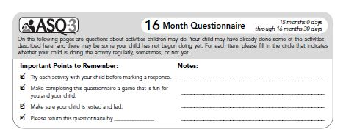
Features: Important Points to Remember
Notes:
“Important Points to Remember” are critical to increased accuracy of the ASQ. They are designed to address common discrepancies between parents’ and professionals’ report of child development. Accuracy is improved when a familiar caregiver reports on observable behaviors in a familiar, comfortable environment over time, when a child is well fed, rested and healthy, and when the caregiver tries out questions that they are not sure of. This also increases the educational impact of the tool.

Slide 14
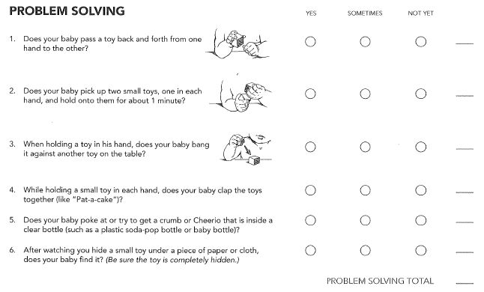
Features: ASQ-3 Areas & Questions
5 developmental areas
6 questions in each area
Response options: Yes, Sometimes, Not Yet
Written at 4th to 6th grade level

Slide 15
Features: ASQ-3 Areas & Questions
Questions ordered in a hierarchy
Questions #5, #6 are average skills for child of that age
  (i.e., a 16-month skill for a 16-month child)
More
Difficult
Notes:
Hierarchical order: This is an important feature to emphasize. Across the series of questionnaires, the questions range in difficulty from approximately a 75 developmental quotient (DQ) to a 100 DQ. See User’s Guide page XX for item level information on DQ’s.
DQ is calculated by taking a skill age level divided by the age of the child. For example, on the 16 month questionnaire in the communication area, the item difficulty looks like this:
#1 and #2 are approximately 12 month skills (DQ=75; 12mo/16mo)
#3 and #4 are approximately 14 month skills (DQ=88; 14 mo/16mo)
#5 and #6 are approximately 16 month skills (DQ=100; 16mo/16mo)
This is a very different tool from a screening tool such as the Denver, which can tell you that a 16 month old child has communication skills at a 20 month age.
State "If a child received a yes on every question in the ASQ, what can we say about that child’s development?"
Answer: That the child is typically developing, right at age level only.

Slide 16
Features: ASQ-3 Overall Section
Un-Scored Section
Looks at quality of skills (e.g., speech)
    - Example: "Does your baby use both hands equally well?"
    - "NO" response indicates possible cerebral palsy; important to follow up
Parent concerns are very predictive
Any concerns or questionable responses require follow-up
Notes:
Overall section - Important for decision making. Captures qualitative information that may not be picked up on the quantitative items - example would be stuttering or stammering which could be identified by the overall question "Does your child talk like other children his/her age?" A child may pass the "scores" in the communication area, but still need services.
Responses from the overall section should always be considered when making referral decisions. Call local Early Intervention or Early Childhood Special Education to get more information about any questionable responses on the Overall Section or refer to child’s primary health care provider for health-related concerns.
ASQ-3 includes new overall questions:
Early language development concerns
Behavioral concerns
Articulation concerns
ASQ-3 User’s Guide includes information on overall question considerations and referral options, see table 6.3 page 73.
Handout: Overall Questions Chart

Slide 17
Features: ASQ-3 Summary Sheet
Each ASQ-3 interval has unique summary sheets
Summary sheets have 5 sections:
  - Child/family information
  - Bar graph with cutoffs
  - Overall section
  - Follow-up action taken (new to ASQ-3)
  - Optional section: Individual item responses
Notes:
The summary sheet (score form) provides a complete summary of questionnaire information. This form could be used to share information with other community agencies who families are involved with and who also have a requirement to screen children. For example, Early Head Start may conduct the screening, but share information with a child’s primary health care provider by sending them a copy of the Summary Form. When sharing results, the optional individual item response section should be completed as then all of the information from the screening is contained on that one sheet.
Important to Remember:
If you are sending this form to another agency/person, the receiving agency must understand ASQ-3 and how to interpret ASQ-3 scoring information.
Recommended Handout: "ASQ-3 Information for Health Providers". This handout can also be referred to when debriefing "Andrew’s Scoring Exercise,” especially for participants who may be sharing information or assisting families in sharing information with pediatricians or other health providers.

Slide 18
Scoring the ASQ-3
Step 1: Review responses. If any missing items, try to obtain answers. If item is inappropriate, omit item
Step 2: Calculate area totals: "yes"= 10; "sometimes"= 5; "not yet"= 0
Step 3: If any items omitted, calculate new area total (see next slide for example)
Notes:
Up to 2 items in one area can be omitted. See ASQ-3 User’s Guide for further guidance.

Slide 19
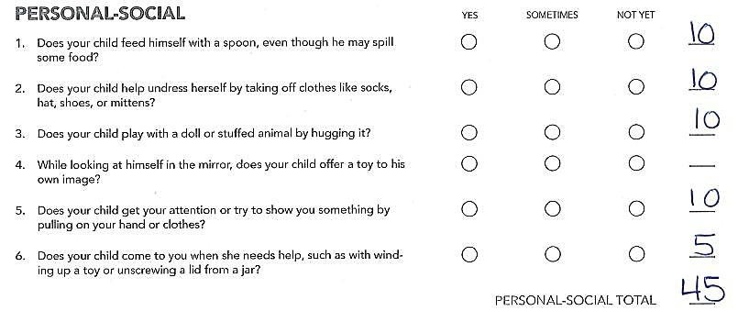
Scoring the ASQ-3
Omitted Items
x
x
x
x
x
Notes:
Up to 2 items in one area can be omitted. See ASQ-3 User’s Guide for further guidance.

Slide 20
Scoring the ASQ-3
Create a new total area score so child is not penalized
  1: Divide total area score by the number of items answered in that area
      45 (area score) ÷ 5 (items) = 9 points
  2: Add this average item score to the total area score
  to get a new total score
      45 + 9 points = new total of 54 points

Slide 21
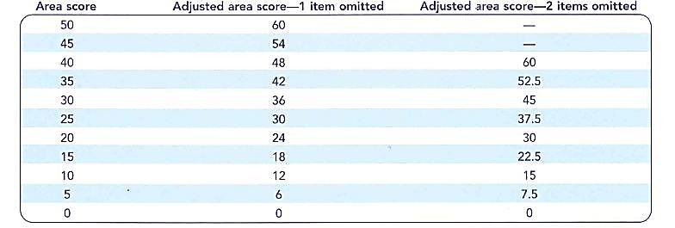
Omitted Items "Score Adjustment Chart"
See ASQ-3™ User’s Guide Table 6.2, ASQ-3™ Quick Start Guide
Notes:
Up to 2 items in one area can be omitted. See ASQ-3 User’s Guide for further guidance.

Slide 22
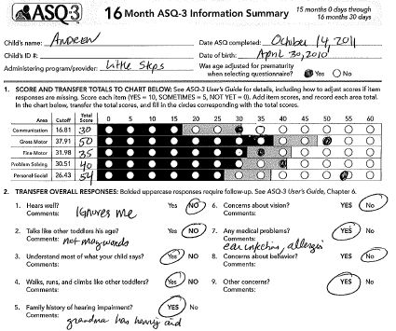
ASQ-3 Information Summary Sheet
(Sections 1 & 2)
Notes:
This is what the summary sheet should look like. Draw participants’ attention to the approximate "bubbling" in the Personal-social domain, as well as the capitalized responses in section #2 pertaining to the Overall responses.

Slide 23
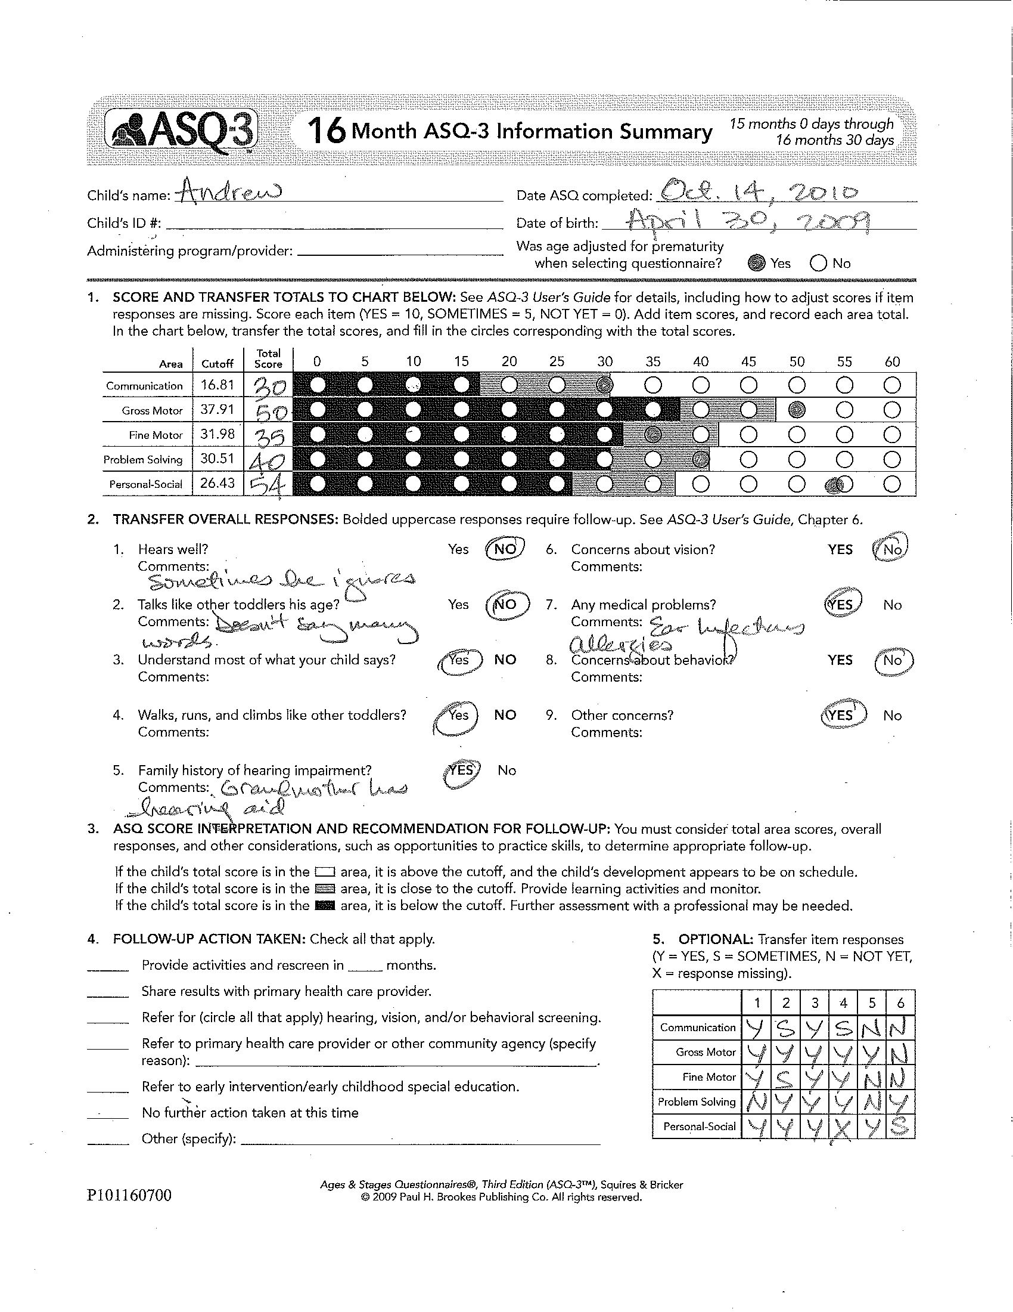
ASQ-3 Information Summary
(Sections 3, 4, & 5)
Notes:
Section 5 is optional. Item responses may be helpful for receiving agencies or for inputting data.
Section 4 is where plans for follow-up are documented.

Slide 24
ASQ-3 Score Interpretation and Recommendation for Follow-Up
  Consider the following to determine appropriate follow-up
    Total ASQ-3 Area Scores
    Overall Responses (Parent Concerns)
    Additional Considerations
      What other factors may have impacted the child’s screening results?
Notes:
Instruct participants to form small groups and together discuss Andrew’s ASQ-3. Participants should generate ideas and questions regarding:
Further information they would like to have regarding Andrew and Vicky
Ideas for possible activities that can be done in a home environment as well as potential referral sources available in their community
Debrief the activity focusing on:
Communication
Fine Motor and Problem Solving
See: "16-Month ASQ Scoring Exercise for Andrew" in Trainer’s Materials

Slide 25
ASQ-3 Score Interpretation and Recommendation for Follow-Up
Additional Considerations
  Biological / Health factors
  Family and cultural context
    stressful life events
    caregiving environment
  Environmental factors
    opportunity to practice skills
  Developmental history
  Extent and frequency of contact
  Availability of resources
Notes:
Exercise: Materials: Flip Chart/Markers
Instead of showing this overhead, have participants share what types of information related to the child/family they consider prior to making referrals.
State "Assessment scores are just one piece of information that we use to make decisions about what to do. What other type of information do you gather to help make those decisions?"
Write down responses on flip chart/discuss answers.

Slide 26
ASQ-3 Score Interpretation and Recommendation for Follow-Up
How might culture or values
influence these activities?
Feeding, Dressing
Reading and Writing Tools
Playing with Toys
  Blocks, stuffed animals, shopping carts
Sports (e.g., balls)
*Adapted from Cross-Cultural Lessons: Early Childhood Developmental Screening and Approaches to Research and Practice. CUP Partnership, Alberta Canada.
Notes:
These are all activities/materials you will find on the ASQ. Discuss how cultural values and parenting practices may impact a child’s performance on these different activities.
Examples of issues that may arise:
Feeding/Dressing: Some cultures feed and dress their babies much longer than "western" cultures and do not encourage self-feeding or children dressing themselves.
Reading/Writing: Some cultures have strong oral traditions; writing may not be emphasized, especially at very young ages...may also be considered a safety issue.
Playing with Toys: Some cultures place a high value on socializing and may not encourage solitary play with toys.
Sports: Some cultures may have strong gender roles and not allow or encourage girls to participate in sport-type activities.
Excerpts from: Cross-Cultural Lessons: Early Childhood Developmental Screening and Approaches to Research and Practice. Community-University Partnership for the Study of Children, Youth, and Families. Edmonton, Alberta, Canada.

Slide 27
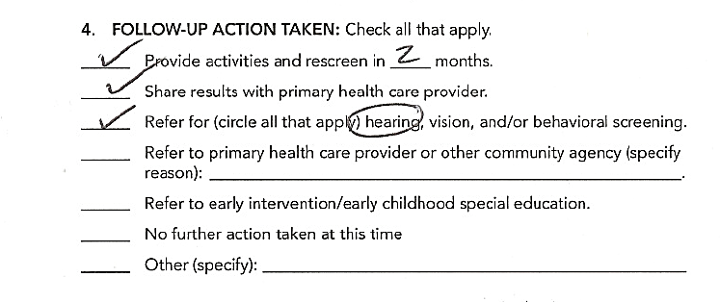
Example of Follow-Up Actions Andrew, Case Study
Notes:
This slide demonstrates potential decisions that might be made for Andrew and Vicky. Note that referral to EI/ECSE (i.e., further evaluation) has not been selected as the family has chosen to try other options first.

Slide 28
ASQ-3 Score Interpretation and Recommendation for Follow-Up
Above monitoring zone
  Provide follow up activities and rescreen in 4-12 months
Monitoring zone
  Score is between 1-2 standard deviations below average
  Provide follow-up activities to practice skills in specific developmental areas
  Rescreen within 2 months in areas of concern
  Make referrals as appropriate
Notes:
Monitoring will depend on program’s contact with families as well as program’s resources. Programs may choose to rescreen in areas of concern soon after the initial screening, or they may choose to stick with their program’s pre-determined screening schedule. For children 1-month to 2-years a 4-6 month monitoring schedule is recommended, and for children 2- to 5½-years a 6-12 month monitoring schedule is recommended.
Referrals: It is important to know your state’s eligibility requirements as in some cases, a referral for evaluation may be appropriate for a child who is low in the monitoring zone. It is also important to follow-up with community-based referrals that do not require meeting an eligibility requirement based upon potential delay. Examples are: parenting programs, Early Head Start, home visiting or family support programs for housing or adult mental health.
Handout (optional): "Referral Decision Matrix"

Slide 29
ASQ-3 Score Interpretation and Recommendation for Follow-Up
Below cutoff in one or more areas
  Score is 2 standard deviations or more below average
  Refer for further assessment
  Rescreen if not eligible for EI or ECSE
Parent Concern
  Respond to all concerns
  Refer if necessary
Notes:
Handout (optional): "Referral Decision Matrix"

Slide 30
Communicating Screening Results
Review the purpose of screening
Avoid terms such as "test,” "pass," or "fail"
(use "below/above cutoff," "in monitoring zone")
Review ASQ-3 and explain area scores
Offer ideas for next steps including:
  activities
  resources
  referral for further evaluation
Support family in decision making process
Notes:
Discussion: What is the primary reason for administering ASQ?
For most programs the goal is to help identify children that might be at risk for developmental delay and to help parents take the next steps toward a potential referral for EI/ESCE. It is important that the parents decide what the next steps might be that seem appropriate for their child and family. Our job is to offer options and provide support and guidance.

Slide 31
Communicating Screening Results
Prepare for the meeting carefully
  Make notes about behaviors
  Note information you need to gather from family (health history, etc.)
  Role-play conversation with a peer
  Select a private, comfortable place
  Consider cultural or language issues
  Know your community resources
  Be calm—remember, you are there to help the family take the next steps…
Notes:
Possible Activity: Role-Play
If your audience has not had much experience with screening or assessment, it is very important to discuss how the results of screening will be shared with families. Often times people don’t realize how difficult this process may be for families when their child falls below cutoff scores or when concerns arise.
Roles that could be assigned include the parent, the "professional" who is responsible for explaining and discussing follow-up options or referral possibilities, other family members, a childcare provider, etc. Having a completed ASQ (one that indicates potential concerns) helps provide a framework for role playing.
Possible questions may be:
How is the family feeling about the child’s development at this point in time?
Do they have concerns?
What are the next steps they would like to take, and how can the provider support them?
Make sure to build from child and family strengths and explore concerns in areas where there are low scores.

